Slide 1
Module 1
Trauma and Sleep: What is Healthy Sleep Anyways?
Madison Bowen
Occupational Therapy Student at the University of Alabama at Birmingham

Slide 2
Outline
01
02
03
Age Appropriate Sleep
What Happens When We Don’t Sleep?
What Is Sleep & What Happens During It
04
05
How Does Trauma Affect Sleep?
Introduction To This Series

Slide 3
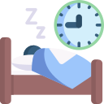
Introduction- What Is Sleep
Researchers theorize that as we sleep our bodies fight off pathogens, repair tissues, and form memories of what we experienced during the day.
Sleep is defined by Merriam Webster as “the natural, easily reversible periodic state of many living things that is marked by the absence of wakefulness and by the loss of consciousness of one's surroundings, is accompanied by a typical body posture (such as lying down with the eyes closed), the occurrence of dreaming, and changes in brain activity and physiological functioning, is made up of cycles of non-REM sleep and REM sleep, and is usually considered essential to the restoration and recovery of vital bodily and mental functions”.
We spend ⅓ of our lives sleeping.
It is part our our everyday routines and is just as essential as food and water.

Slide 4
The Two Processes of Sleep Regulation
Homeostatic Sleep Drive or “Sleep Pressure”
Circadian Clock
An internally driven 24 hour cycle that strongest cue is the sun and light.
The longer we are awake the larger the pressure gets until we sleep. Then, the process begins again.

Slide 5
What Is Sleep Debt?
Essentially, your body needs you “pay” in sleep that you missed.
For example, if your body needs 8 hours of sleep and you only get 6 hours. You have accumulated a 2 hour debt that needs to be paid.
This can cause lower cognitive performance overall.
This is why it is important to get adequate sleep consistently to prevent acquiring this debt.

Slide 6
Recommended Hours of Sleep By Age
It has been proven that sleeping the recommended hours of sleep on a consistent basis is associated with:
Behavior
Improved Attention & Learning
Mental and Physical Health
Memory
Emotional Regulation
Quality of Life

Slide 7
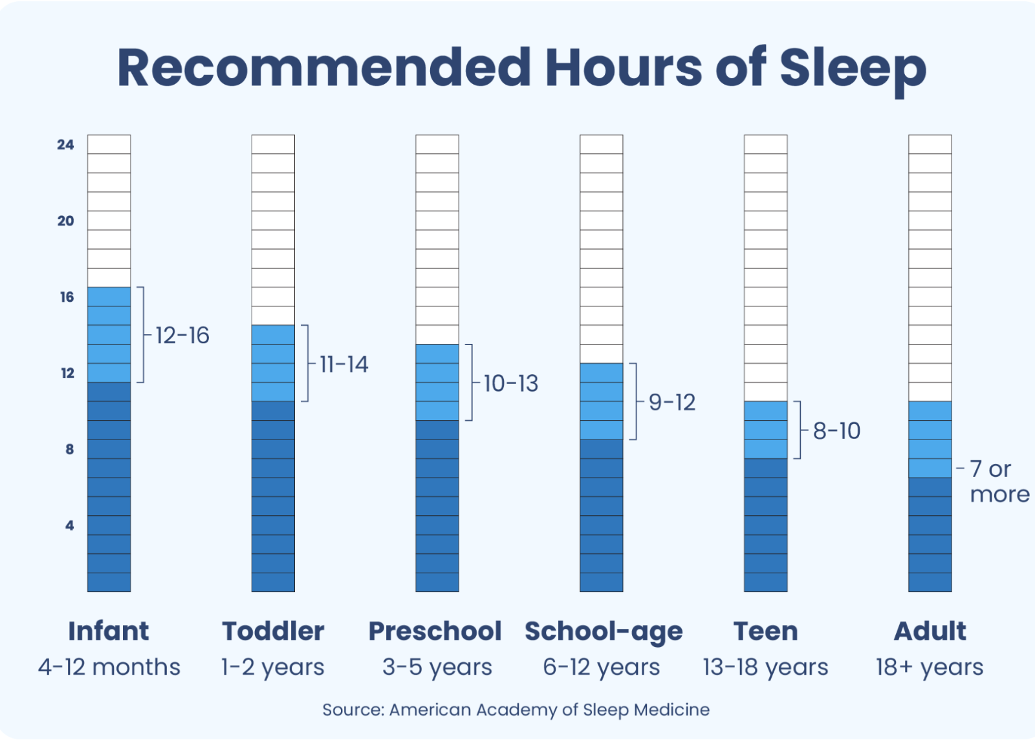
Recommended Hours of Sleep By Age
Infant, toddler, and preschool age all include naps in total hours for healthy sleep
Infant: 4-12 months
12-16 hours
Toddler: 1-2 Years
11-14 hours
Preschool: 3-5 Years
10-13 hours
School- age: 6-12 Years
9-12 hours
Teen: 13-18 Years
8-10 hours
Adult: 18+ Years
7 or more

Slide 8
Optimal Amount of Sleep: What is Too Much and Too Little
According to a panel of experts in sleep medicine and/or sleep science,
Infant
1 to <3 years
3 to <6 years
6 to <13 years
13 to 18 years
<12 hours of sleep and >/=18 hours
<10 hours of sleep and >16 hours
<10 hours and >14 hours
>13 hours
<8 hours and >10 on a regular basis
The above data shows the ranges for inappropriate sleep to support optimal health

Slide 9
How Many Naps By Age
Newborn 1-2 Months:
Throughout the day
3-11 Months:
3-4 times daily and 30 minutes- 2 hours in duration
1-3 Years:
3-4 times daily and 30 minutes- 2 hours in duration
3.1-4.11 Years:
Once daily

Slide 10
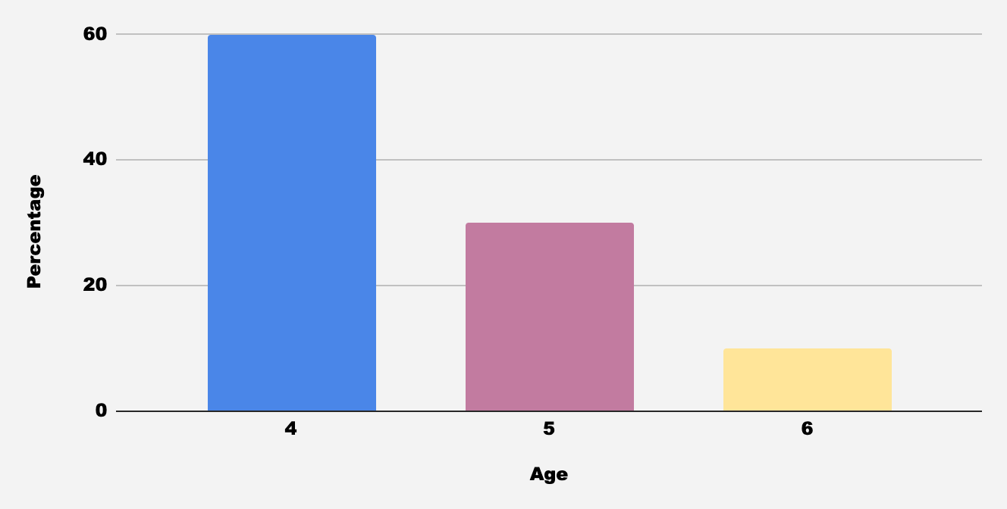
Napping Through Young Life
At 4 years old 60% of children nap, at 5 years old 30% of children still nap, and at 6 years old 10% still nap

Slide 11
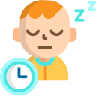
When To Stop Napping
As children get older, they naturally age out of naps.
It may be time to cease nap time if you notice:
Your child is waking up earlier than normal
Your child is having difficulty falling asleep
Your child is having difficulty falling asleep at nap time
When you skip nap time, they are not showing signs of being tired
Instead you can fill this time with quiet activity:
A period of rest can promote increased energy for the rest of the day and memory consolidation.
Ideas: coloring, reading, crafting, puzzles
Try to avoid replacing this time activities that promote drowsiness such as watching T.V or loud activity that can be stimulating.

Slide 12
What Happens When Children Don’t Sleep
When children do not sleep it can impact their physical, cognitive, behavioral, and biological health.
Physical Symptoms
Biological
Symptoms
Behavioral
Cognitive
Blurred Vision
Fatigue
Tiredness
Daytime sleepiness
Change in appetite
Muscle repair and hormone release are stunted increasing the risk of sickness
Hypertension
Obesity
Stress
Aggressive Behavior
Anxiety
Depression
Impulsivity
Decision Making
Working Memory
Learning
From these symptoms comes disruption of the completion of activities or occupations within these routines such as social participation, leisure participation, school, work, and play

Slide 13
What Happens When Caregivers Don’t Sleep
When children are sleep deprived, caregivers are sleep deprived
This in turn effects the caregivers ability to fill role expectations. This includes the role of parent, spouse, student, employee etc.
Symptoms can include reduced concentration, increased stress, irritability, impaired sleep quality, and increased sleepiness during the day.

Slide 14
Foster Care & Sleep
59%
44%
These rates are 2 to 6 times higher than the general population at this age
11 to 12 year olds in foster care had difficulty falling and staying asleep in foster care
13 to 17 year olds had difficulty falling and staying asleep in foster care

Slide 15
Trauma and Sleep
What is Trauma?
46%
John James
22%
Of 17 year olds or younger, report experienced more than two types of trauma
Of 17 year olds or younger, report experiencing at least one trauma.
As defined by the National Child Traumatic Stress Network it is “ a frightening, dangerous, or violent event that poses a threat to a child’s life or bodily integrity.
Additionally, “Witnessing an event that threatens the life or physical security of a loved one can also be traumatic.

Slide 16
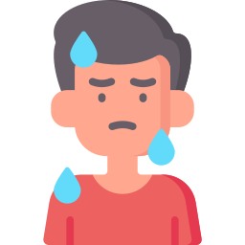
Trauma and Sleep
The Body & Trauma
When faced with a trauma or experiencing a reminder or “trigger”, the body has a natural response known as “fight, flight, freeze, or fawn”
The body is preparing to protect itself by activating the nervous system releasing three hormones known as norepinephrine, epinephrine, and cortisol.

Slide 17
Body Responses To The Release Of Stress Hormones
Slowed Digestion
Heart Accelerates
Pupils Dilate
Muscles Tense
Fast Breathing
The body, after releasing the three hormones, secretes them into the bloodstream preparing the body to defend itself.

Slide 18
Responses To Fear & Trauma
Fear Response
Fight
Flight
Freeze
Fawn
The built in defense mechanism triggered by fear or trauma whether physical or psychological
Facing the danger and fighting the threat aggressively
Actions: tight jaw, upset stomach, intense anger, crying, attacking
Running away from the threat to try and save yourself
Actions: constantly moving feet, legs, and arms, feeling trapped, sense of numbness
Equivalent to playing dead through not moving until the threat passes
Actions: pounding heart, pale skin, sense of dread
A submissive response that serves to avoid conflict
Actions: agreeable and helpful regardless of feelings

Slide 19
Long Term Effects
Our bodies are not designed to live in a “fear response” over and over
It results in changes in how the brain. It allows the automatic fear reactions to overcome conscious thinking.
Chronically increased cortisol levels leave children on edge or “over-reactive”. It can also leave children “shutting down” during real threats.
Example:
A person who has a phobia of heights may find themselves in a stress response on an airplane or walking up a flight of stairs. Things that are normal to us may trigger a response in them causing panic

Slide 20
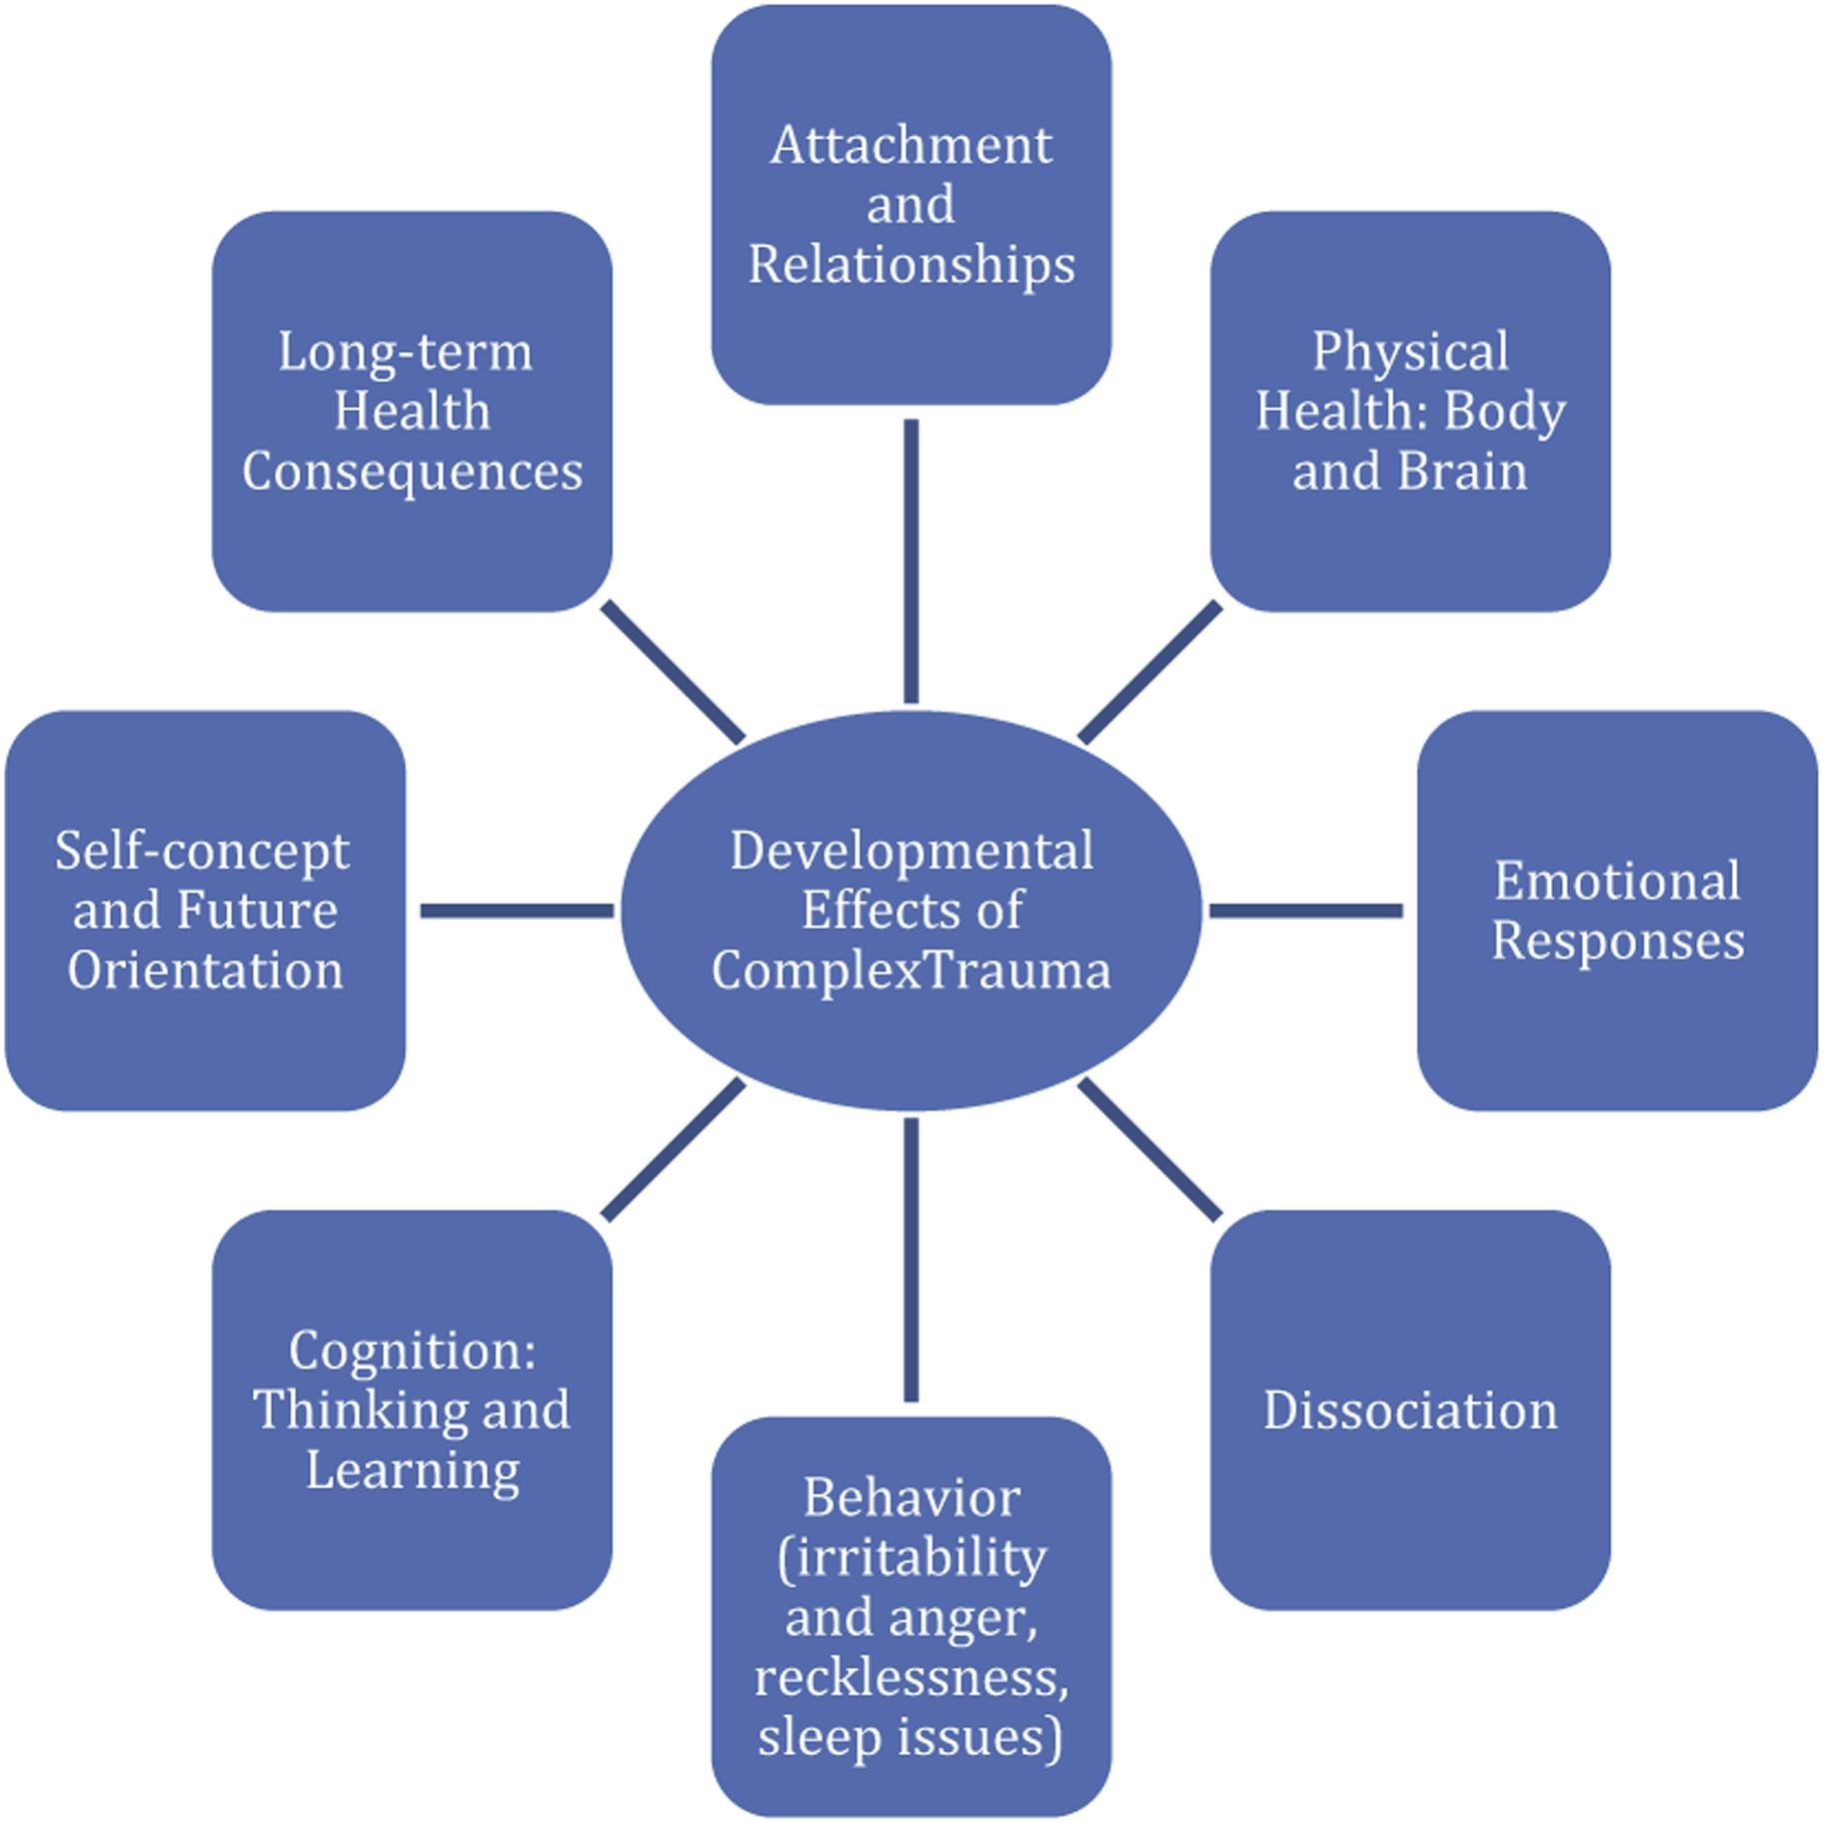
Trauma and Sleep
When trauma is repeated or multiple traumatic experiences occur, it can cause complex effects across the lifespan.
Many individuals are undiagnosed with complex trauma and are often misdiagnosed with attention-deficit/hyperactivity disorder (ADHD), conduct disorder, oppositional defiant disorder, and bipolar disorder
Fellman, V., Heppell, P. J., & Rao, S. (2024). Afraid and Awake: The Interaction Between Trauma and Sleep in Children and Adolescents.

Slide 21
Trauma and Sleep
Complex trauma often comes with mood and anxiety symptoms. It often also comes with behavioral dysregulation.
These symptoms can be a form of communication for those caring for them
Meeting these “behaviors” with empathy, understanding, and normalization can be the key to understanding their trauma and choosing the correct strategies to help them

Slide 22
Trauma and Sleep
Trauma is different for everyone and has different implications for sleep unique to the type of trauma.
Again, looking closely at the actions of a foster child around bedtime can point you to what areas you can adjust or aid in to facilitate sleep.
Example: A child may experience abandonment and be afraid to be alone when sleeping or another child may have experienced abuse at night and want to be completely alone to feel safe.
They both have trauma and anxiety around sleep manifesting in different ways causing sleep issues.

Slide 23
Trauma and Sleep
The Body & Trauma
Attachment
John James
Children often look to their parents to soothe fears.
When a child enters you home, healthy attachment has to be created and does not come automatically
It is completely normal for attachment to take time and they can be created through trust and safety.
Being physically safe does not always equal feeling safe
Early experiences of trauma create dysregulation or disruption of the stress response system.
This can create a child that is extremely hyper vigilant and has hyperarousal even what there is no physical threat.
For the child, the threat is very real.

Slide 24
Imagine
Additionally, as you try to go to sleep your body is working against you. You are fearful, your heart is beating fast, and you are trying to catch your breath but can’t.
Could you sleep?
You are a foster child who has just been placed into foster care. You have past trauma, and it is time for you to go to sleep for a new school in the morning. You not only have a new caregiver and new foster siblings but a new room, a new routine, and new clothes. You cannot help but worry about your siblings that got a different placement and if you will see them again.

Slide 25
Common Conditions
86%
65.1%
62.7%
62.7%
62.7%
According to a group of 43 foster care licensing agency personnel, who work directly with foster families, were surveyed about their experiences and their perceptions of sleep among the children they serve.
Difficulty Falling Asleep
Resisting/Refusing To Go To Sleep
Wetting The Bed
Nightmares
Nighttime Fears

Slide 26
Trauma And Sleep: The Good News
Quality sleep is dependent on three factors:
Consistent routines
Secure Attachment
A Predictable Environment
Because of our knowledge of this, the next two modules, “Sleep and The Senses: Strategies to Create An Environment To Encourage Sleep” and “Increasing Independence And Confidence Around Sleep Through Choice” will focus on strategies to address these three factors in order to facilitate sleep for your foster children.
Our Main Goal: Instill confidence into those watching to use the applicable information and resources provided to encourage healthy and safe sleep of their foster children.

Slide 27
Do You Want to Know More?
Each module will have a quiz attached to take that will direct you to the next video. Once all videos and quizzes have been completed, there will be a survey. Once the survey is complete, the page will present a link to your certificate for continuing education credits.

Slide 28
Thank You!

Slide 29
Sources
Akerstedt, T., Kecklund, G., & Axelsson, J. (2007). Impaired sleep after bedtime stress and worries. Biological psychology, 76(3), 170–173. https://doi.org/10.1016/j.biopsycho.2007.07.010
Alfano, C. A. (2020). Foster agency workers’ perceptions of sleep health among children in foster care. Children and Youth Services Review, 117, Article 105316. https://doi.org/10.1016/j.childyouth.2020.105316
Alfano, C. A., Valentine, M., Nogales, J. M., Kim, J., Kim, J. S., Rigos, P., McGlinchey, E. L., Ripple, C. H., & Wolfson, A. R. (2022). How Are the Sleep Problems of Children in the US Foster Care System Addressed? Journal of Developmental and Behavioral Pediatrics, 43(8), e525–e532. https://doi.org/10.1097/DBP.0000000000001090
Akacem, L. D., Simpkin, C. T., Carskadon, M. A., Wright, K. P., Jr, Jenni, O. G., Achermann, P., & LeBourgeois, M. K. (2015). The Timing of the Circadian Clock and Sleep Differ between Napping and Non-Napping Toddlers. PloS one, 10(4), e0125181. https://doi.org/10.1371/journal.pone.0125181
Borbély, A. (2022). The two‐process model of sleep regulation: Beginnings and outlook. Journal of Sleep Research, 31(4), e13598-n/a. https://doi.org/10.1111/jsr.13598
Czeisler, C. A. (2009). Medical and genetic differences in the adverse impact of sleep loss on performance: ethical considerations for the medical profession. Transactions of the American Clinical and Climatological Association, 120, 249–285.
Daan, S., Beersma, D. G., & Borbely, A. A. (1984). Timing of human sleep: recovery process gated by a circadian pacemaker. American Journal of Physiology. Regulatory, Integrative and Comparative Physiology, 246(2), 161-R183. https://doi.org/10.1152/ajpregu.1984.246.2.r161
Dahl, R. (1996). The regulation of sleep and arousal: Development and psychopathology. Development and Psychopathology, 8(1), 3–27. https://doi.org/10.1017/ S0954579400006945.
Dozier, M. (2005). Challenges of foster care. Attachment & Human Development, 7(1), 27–30. https://doi.org/10.1080/14616730500039747

Slide 30
Sources
Fellman, V., Heppell, P. J., & Rao, S. (2024). Afraid and Awake: The Interaction Between Trauma and Sleep in Children and Adolescents. The Psychiatric Clinics of North America, 47(1), 229–253. https://doi.org/10.1016/j.psc.2023.06.015
Frothingham MB. (2021). Fight, flight, freeze, or fawn: what this response means. Simply Psychol. https://www.simplypsychology.org/fight-flight-freeze-fawn.html.
Gerson, R., & Heppell, P. (2019). Beyond PTSD: The Complexity of Diagnosis and Treatment for Teens in Child Welfare Custody. Psychiatric News, 54(7). https://doi.org/10.1176/appi.pn.2019.4a25
Lehmann, S., Gärtner Askeland, K., & Hysing, M. (2021). Sleep among youths in foster care: Associations with potentially traumatic events, PTSD and mental health. Child & Family Social Work, 26(1), 111–121. https://doi.org/10.1111/cfs.12794
Liu, J., Ji, X., Pitt, S., Wang, G., Rovit, E., Lipman, T., & Jiang, F. (2024). Childhood sleep: physical, cognitive, and behavioral consequences and implications. World journal of pediatrics : WJP, 20(2), 122–132. https://doi.org/10.1007/s12519-022-00647-w
Merriam-Webster. (n.d.). Sleep definition & meaning. Merriam-Webster. https://www.merriam-webster.com/dictionary/sleep
Mindell, J. A., Li, A. M., Sadeh, A., Kwon, R., & Goh, D. Y. T. (2015). Bedtime routines for young children: a dose-dependent association with sleep outcomes. Sleep (New York, N.Y.), 38(5), 717–722. https://doi.org/10.5665/sleep.4662
O’Brien, J. C., & Kuhaneck , H. (2020). Sleep and Rest . In Occupational Therapy for Children and Adolescents (Eighth, pp. 521–538). essay, Elsevier, Inc. .
Paruthi, S., Brooks, L. J., D’Ambrosio, C., Hall, W. A., Kotagal, S., Lloyd, R. M., Malow, B. A., Maski, K., Nichols, C., Quan, S. F., Rosen, C. L., Troester, M. M., & Wise, M. S. (2016). Consensus Statement of the American Academy of Sleep Medicine on the Recommended Amount of Sleep for Healthy Children: Methodology and Discussion. Journal of Clinical Sleep Medicine, 12(11), 1549–1561. https://doi.org/10.5664/jcsm.6288

Slide 31
Sources
Peterson, S. (2018, June 11). Effects. The National Child Traumatic Stress Network https://www.nctsn.org/what-is-child-trauma/trauma-types/complex-trauma/effects
Tambini, A., Ketz, N., & Davachi, L. (2010). Enhanced Brain Correlations during Rest Are Related to Memory for Recent Experiences. Neuron (Cambridge, Mass.), 65(2), 280–290. https://doi.org/10.1016/j.neuron.2010.01.001
Vyas, N., & Summer, J. (2024, March 11). When should kids stop napping?. Sleep Foundation. https://www.sleepfoundation.org/children-and-sleep/when-do-kids-stop-napping
Yang, F. N., Xie, W., & Wang, Z. (2022). Effects of sleep duration on neurocognitive development in early adolescents in the USA: a propensity score matched, longitudinal, observational study. The Lancet. Child & adolescent health, 6(10), 705–712. https://doi.org/10.1016/S2352-4642(22)00188-2

